Slide 1


WattWise
Monitor. Track. Save.
Notes:
1

Slide 2



THE PRODUCT
Know what your home is using.
WattWise is an Android app designed to track appliance energy consumption and simplify household power management.
APPLIANCE-LEVEL TRACKING
HOUSEHOLD CONTROL
Notes:
2

Slide 3



WHY IT MATTERS
Understanding your usage is the first step to planning ahead.
See the pattern
before the bill.
Without a record, it is hard to tell which appliances contribute most to the monthly electric bill, or choose how to manage your energy use based on your own data.
Observe
Compare
Plan ahead
Notes:
3

Slide 4

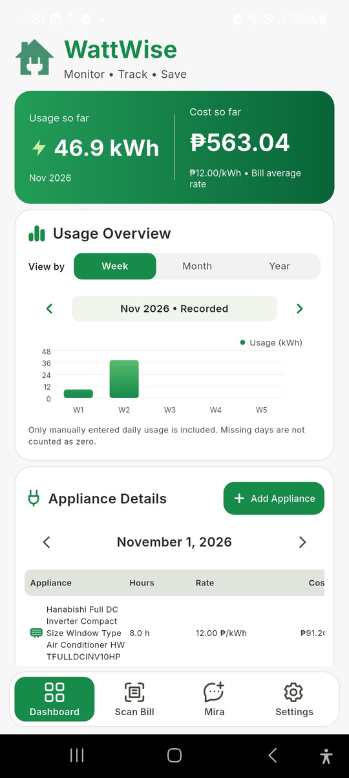
WATTWISE DASHBOARD
From monthly rate to appliance detail.
The dashboard brings the working pieces together:
MONTHLY RATE
USAGE OVERVIEW
Estimate cost using the current rate.
See usage across week, month, or year.
APPLIANCE DETAILS ENTRY
COST ESTIMATION
Translate usage into a clearer estimate.
Add appliances and their wattage.
Notes:
4

Slide 5

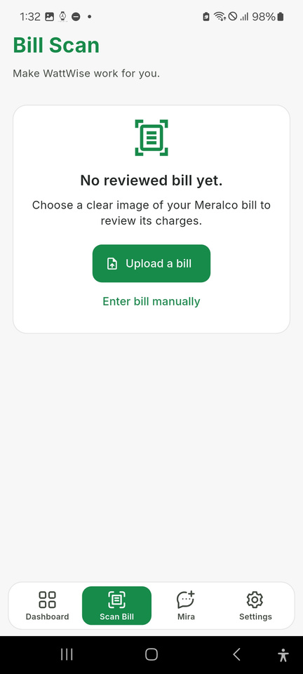
BILL INPUT
To easily understand the fragments of bills break down
01
02
03
Bill Scan
Or Enter manually
Bill Saved
Upload a picture; WattWise inputs the bill automatically.
Enter bill details manually if scanning isn't available.
Review charges, rate calculation, insights, and saving opportunities.
Notes:
5

Slide 6
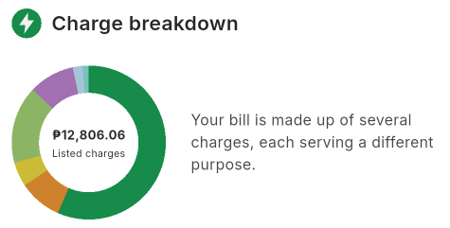
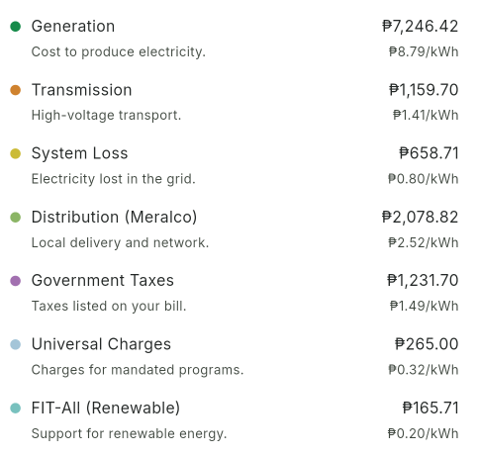
BILL CHARGE BREAKDOWN
One bill. Several jobs.
WattWise makes the fragments of a bill easier to understand by showing where each charge belongs.
CHARGE BREAKDOWN
CLEARER CONTEXT
Notes:
6

Slide 7
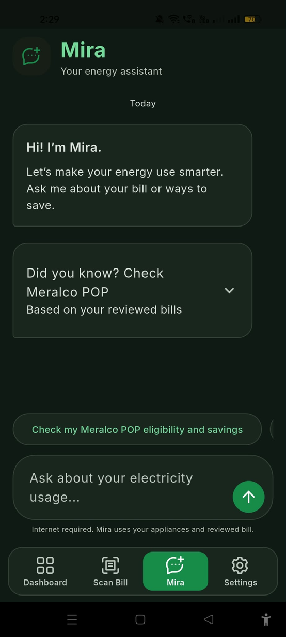
MIRA
Your AI energy assistant.
Mira helps you understand your power habits by answering questions about your bill, identifying high-consumption appliances, and suggesting smarter ways to save energy every day.
She also answers questions about your listed electrical appliances.
Notes:
7

Slide 8

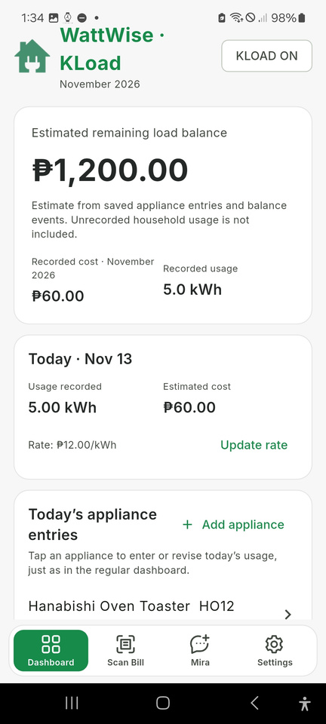
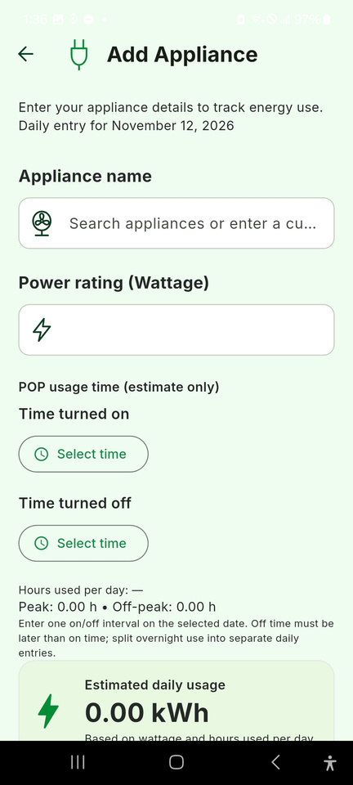
Rate and plans Adjustment
KLOAD
POP
Match the calculation to your current plan.
Toggle Peak/Off-Peak (POP) or Kuryente Load in Settings to automatically adjust cost calculations and switch your dashboard view to match your Meralco plan.
Peak
Off-Peak
Higher-demand period.
Lower-demand period.
Notes:
8

Slide 9
EXPECTED IMPACT
1
2
3
Greater awareness
Clearer bill understanding
Better planning
Use estimates, usage history, and prepaid load balance estimates (KLoad) to prepare ahead.
See which appliances are estimated to use more energy and how usage changes over time.
Read charge categories and compare them with appliance estimates.
Awareness
becomes action.
4
5
More informed decisions
Stronger energy habits
Mira’s guidance is based on the household’s own saved data.
Regular logging and bill review encourage closer attention to electricity use.
Notes:
9

Slide 10


THE OPPORTUNITY
A smarter path
to an efficient energy usage.
Thank you for reviewing this opportunity
From WattSense!
Notes:
10

